Slide 1
The State of Threats: Safeguarding the Health System Against Various Modes of Attacks
Presented By:
Farheen Ali, Sonia Daneshwar, Jacob Jones, Tyler Ramos
April 25th, 2023

Slide 2
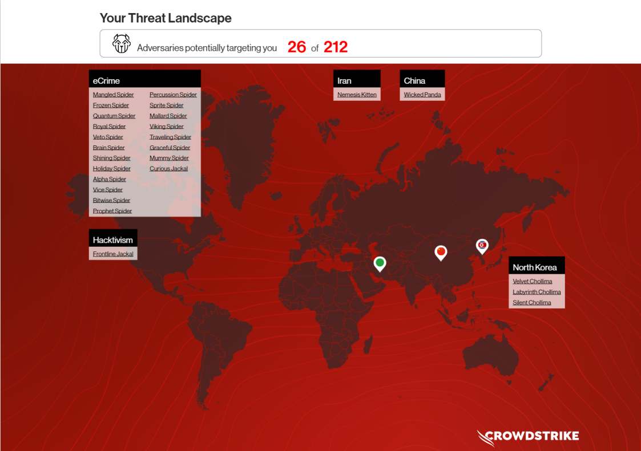
State of Threats
CrowdStrike tracks 26 threat actors actively targeting mid sized hospitals
File Exfiltration
Ransomware
Information Exfiltration
Monetary Exfiltration
Notes:
Spiders range from RATs to access systems to fake site creators to convince staff to upload data to the wrong site
Others focus on getting in grabbing data exfiltrating data and getting out
Others include attacks on financial data these hospitals store to directly access funds
Many attacks currently follow multiple methods to gain access, retain access, and get as much out of the attack as possible

Slide 3
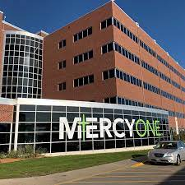


Real Events
Hospital Almost Gives Child an Overdose
Baby’s Life Cut Short Due to Ransomware Attack
Hospital “Unable” to Treat German Women

Slide 4
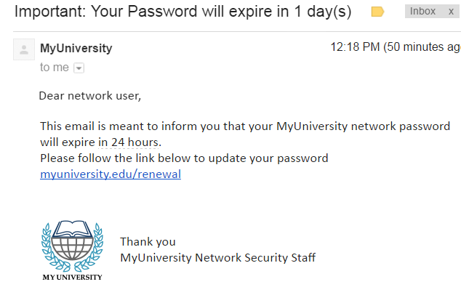
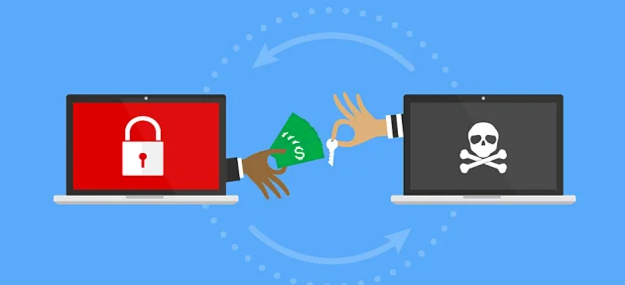
Modes of Attacks
Phishing
Phishing is the practice of infecting a seemingly innocuous email with malicious links.
Phishing links are made to look very convincing, and try to impersonate an organization or person with credibility.
Ransomware Attacks
Malware is injected into a network to infect and encrypt sensitive data, and this data is then held hostage until a ransom is paid.
Malware, or malicious software, is a blanket term for any kind of computer software with malicious intent.
Phishing is typically used to inject malware into a system.

Slide 5
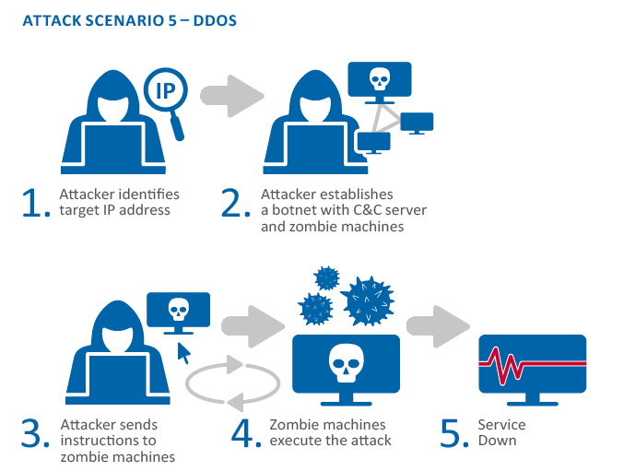
Modes of Attacks
Data Breaches
Breaches are at a disproportionately large amount in the healthcare industry.
In 2020, the average number of data breaches that occurred every day in the healthcare sector was 1.76.
This threat landscape could facilitate indirect access to sensitive data, such as:
Social security numbers
Credit card numbers
Medical device intellectual property
DDoS Attacks
A Distributed-Denial-Of-Service attack is when many fake connection requests are sent to the targeted server, forcing it to go offline.
A botnet can be created in a hospital that recruits all IoT devices to participate in the attack.

Slide 6
How Can The Healthcare System Prepare?
Future breaches are always inevitable but hospitals can make it harder to happen..
Require staff to take training in cybersecurity, with a focus on phishing attempts through email, and social engineering.
The Canadian Internet Registration Authority does training that simulates phishing attacks, which has resulted in a decrease on malicious links being clicked by two-thirds.
The Cybersecurity and Infrastructure Security Agency suggested to use a the 3-2-1-backup method:
Keep 3 copies of your data - 1 primary and 2 backups
Have 2 different media types -- protects against different types of hazards
1 copy off-site for disaster recovery.
Companies should opt for physical devices with security embedded in it already.

Slide 7
RESOURCES
https://www.wired.co.uk/article/ransomware-hospital-death-germany
https://online.maryville.edu/blog/healthcare-cybersecurity/
https://www.wired.co.uk/article/ransomware-hospital-death-germany
https://www.wsj.com/articles/ransomware-hackers-hospital-first-alleged-death-11633008116
https://www.nbcnews.com/tech/security/ransomware-attacks-hospitals-take-toll-patients-rcna54090
https://www.crowdstrike.com/adversaries
https://www.upguard.com/blog/biggest-cyber-threats-in-healthcare
https://www.ncbi.nlm.nih.gov/pmc/articles/PMC6989022/
https://www.malwarebytes.com/malware

Slide 8
Images used
https://www.imperva.com/learn/wp-content/uploads/sites/13/2019/01/phishing-attack-email-example.png

